Slide 1
Class-based Views

Slide 2
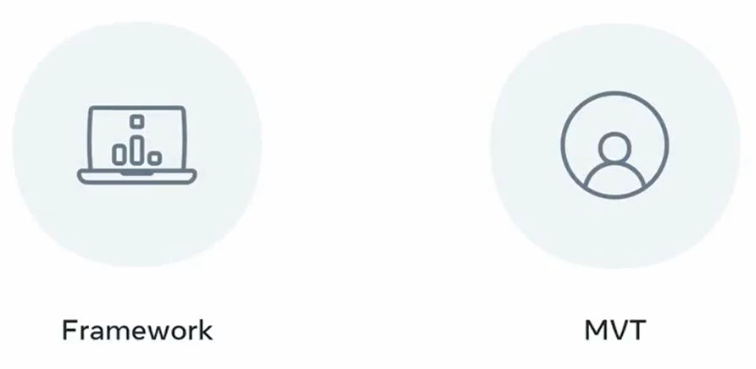

Slide 3
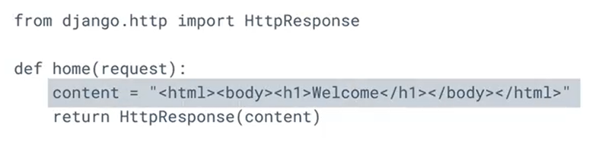
Views.py

Slide 4
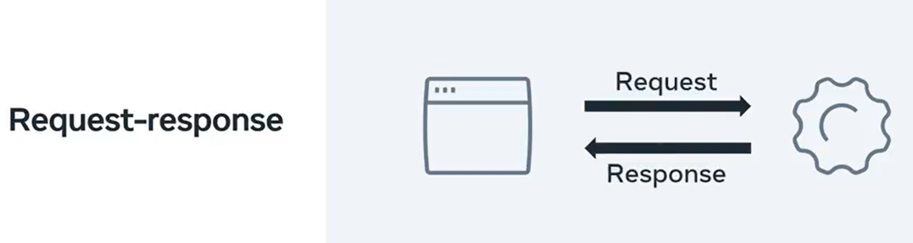

Slide 5
Class-based view

Slide 6
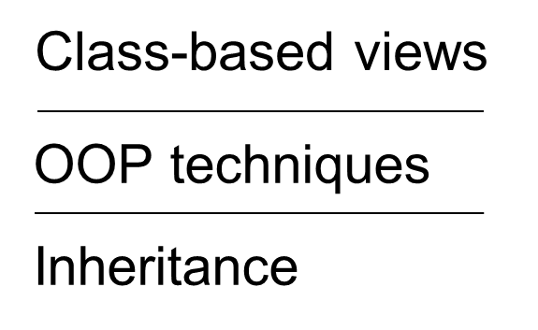

Slide 7


Slide 8
GET
POST
Methods
Core of CRUD operations
PUT
DELETE

Slide 9
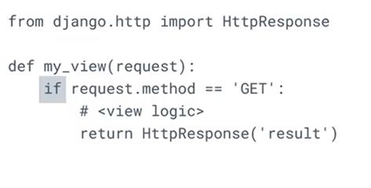
Views.py

Slide 10
Class-instance methods

Slide 11
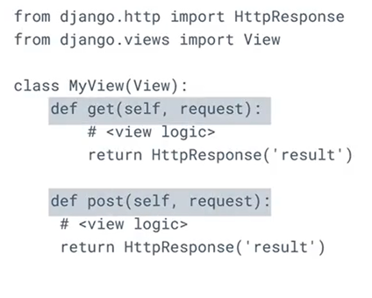
Views.py

Slide 12
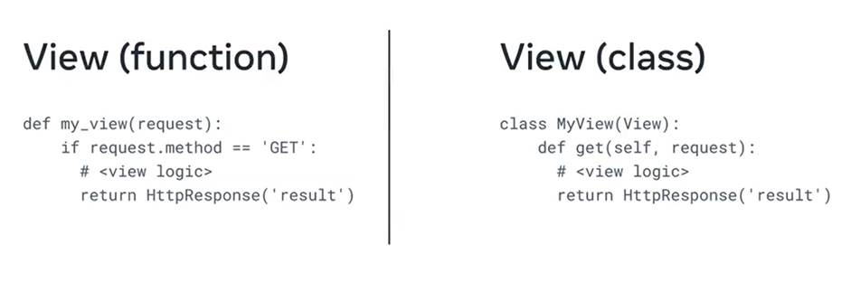

Slide 13
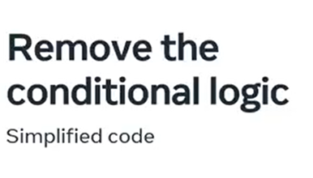

Slide 14
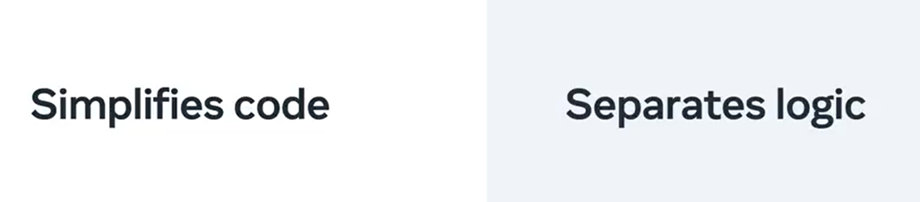

Slide 15
Extend functionality
Using Mixins

Slide 16
Mixins
Flexible Class-based generic views

Slide 17


Slide 18
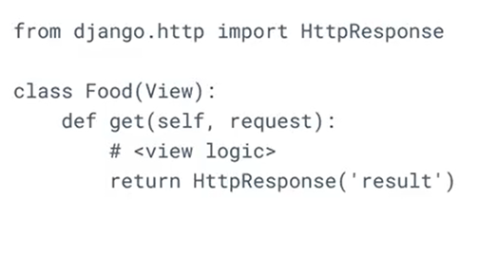
views.py

Slide 19
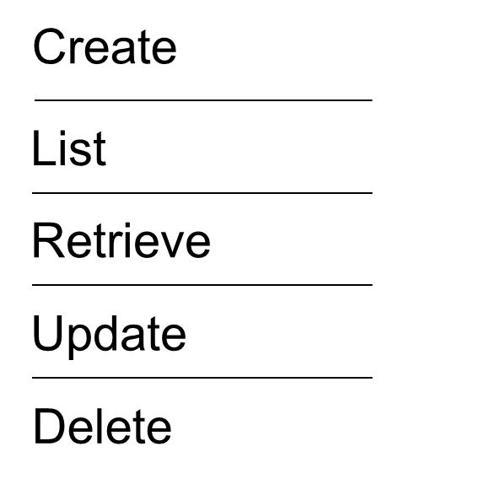

Slide 20

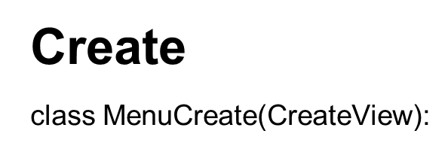

Slide 21

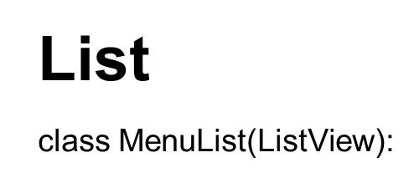

Slide 22

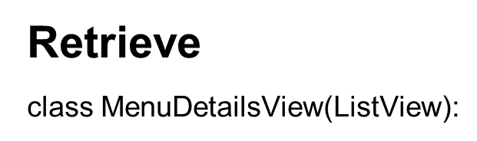

Slide 23

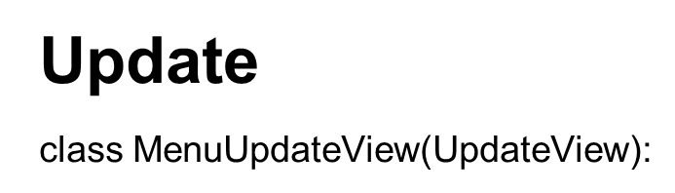

Slide 24

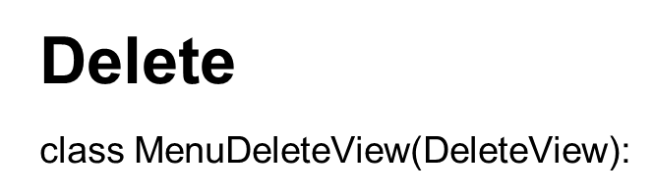

Slide 25


